Slide 1

Unit -3 Stages of Writing
By Madhuri maam

Slide 2
3.1 importance of writing for career making
3.1.1 communication skills
3.1.2 professionalism
3.1.3. Career Advancement
3.1.4. Critical Thinking
3.1.5. Visibility and Influence
3.1.6. Documentation
3.1.7. Global Reach
3.1.8. Marketing and Branding
3.2 Pre-Writing- selecting a topic
3.3 Writing- Free Writing, Drafting
3.4 Re-writing- Revision, editing, proofreading.

Slide 3
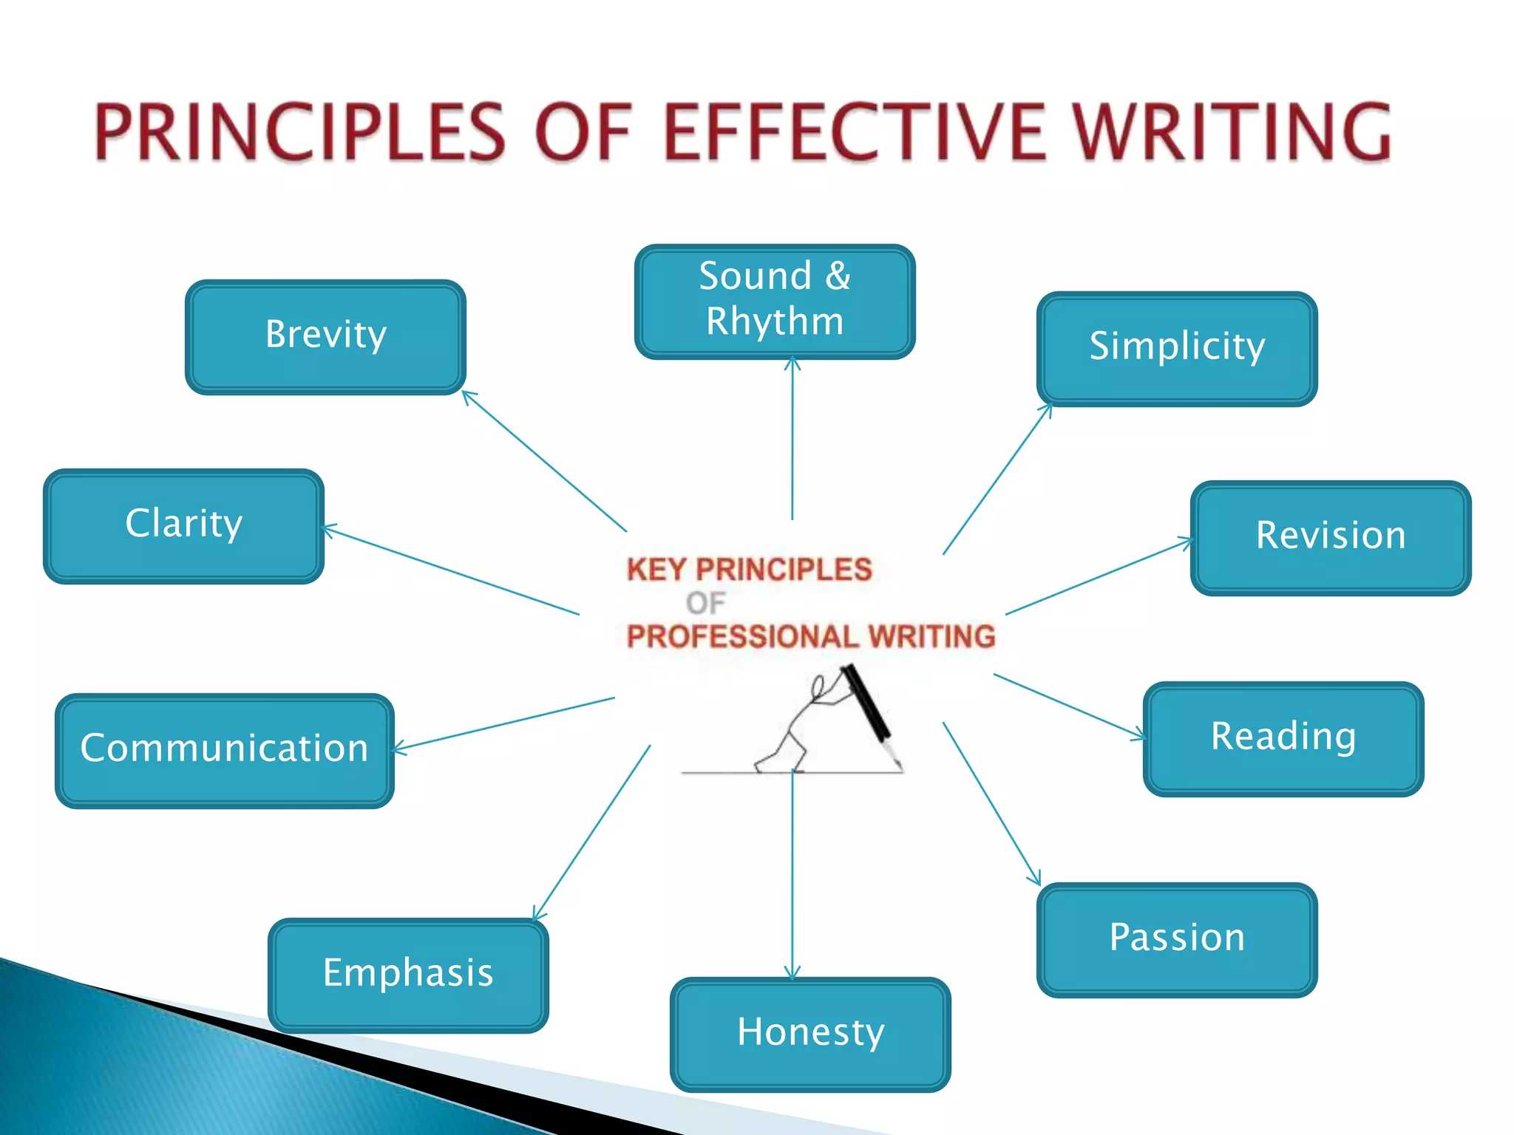

Slide 5
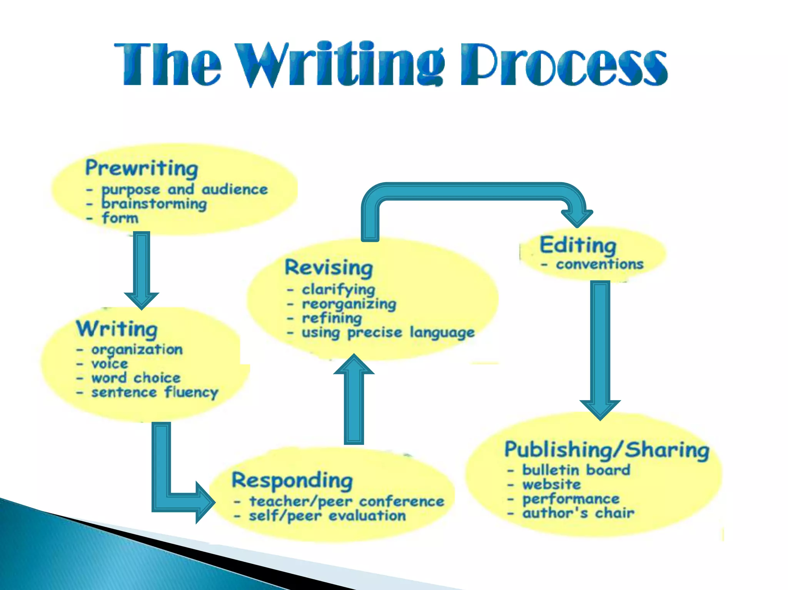

Slide 6
3.1 Importance of writing for career making
Good writing skills can help you communicate better and create better relationships with your teammates. Strong written communication skills are one of the top attributes employers look for, regardless of the job they're hiring to fill. The act of writing implies the process of self-knowledge.
Writing plays a crucial role in career development across various fields. Here are some reasons why writing is important for building a successful career:

Slide 7
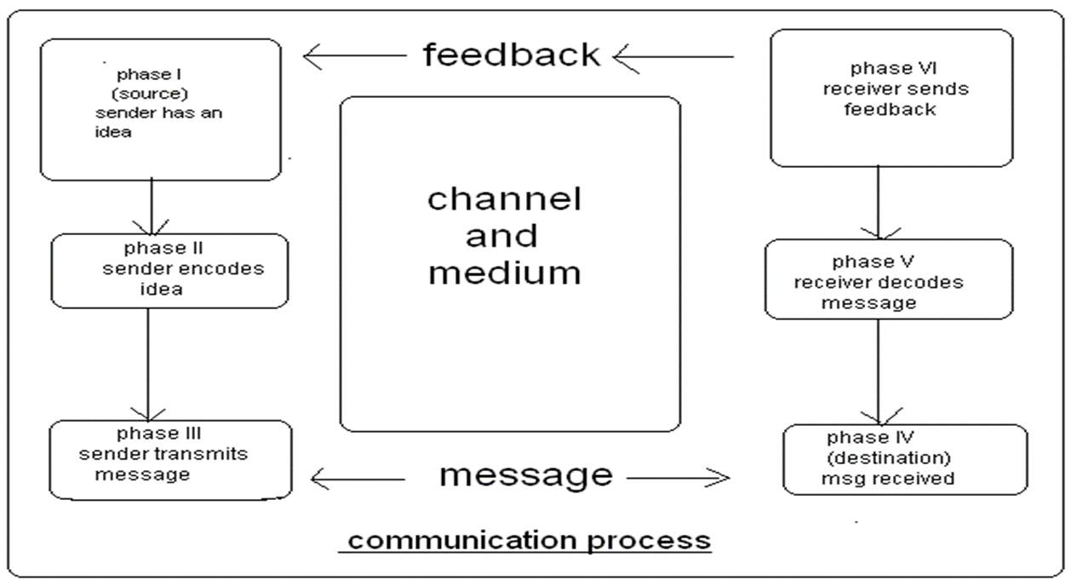
3.1.1 communication skills
Communication is “an interaction between 2 or more persons that involves the exchange of information between a sender and a receiver”
It involves the expression of emotions, ideas, and thoughts through verbal and non-verbal signals.

Slide 8
Nonverbal Communication
Verbal communication
Includes spoken and written word
Tone
Volume
Cultural differences
Jargon
Slang
All behaviors that express messages without the use of words
Body movement
Physical appearance
Personal space
Touch
Body language
Should be consistent with spoken word
Cultural considerations

Slide 9
Essential Skills
Active listening
Clarifying
Comforting
Focusing
Genuineness
Informing
Interviewing
Paraphrasing
Reflecting
Restating
Summarizing
Suggesting
Open-ended statements and questions

Slide 10
3.1.2 Professionalism
Professionalism refers to the conduct, behavior, and attitude exhibited by individuals in a work or business environment that demonstrates a commitment to ethical standards, competence, and proper decorum.
It includes qualities such as reliability, responsibility, integrity, respect for others, adherence to company policies, effective communication, and the continuous pursuit of excellence and self-improvement.
Professionalism also involves maintaining a high level of competence and skill in one’s area of expertise, as well as being accountable for one’s actions and decisions.

Slide 11
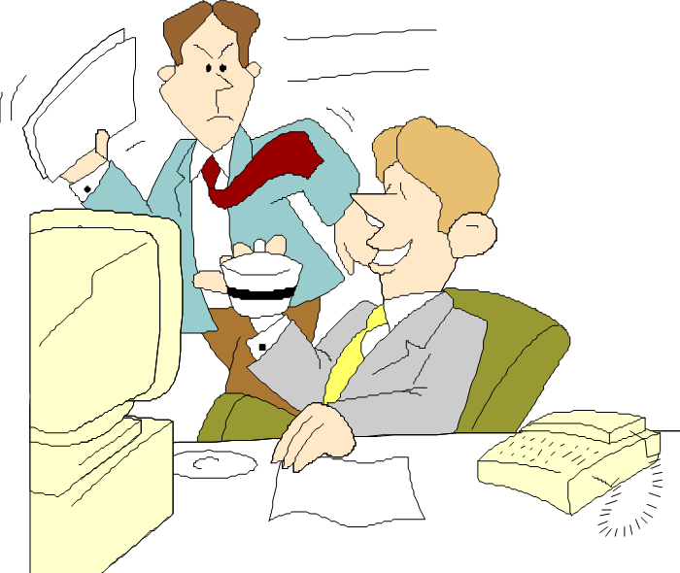
Presentation of self
business etiquette
office politics
Empathy
Job performance
Customer service
Ethical decision-making

Slide 12
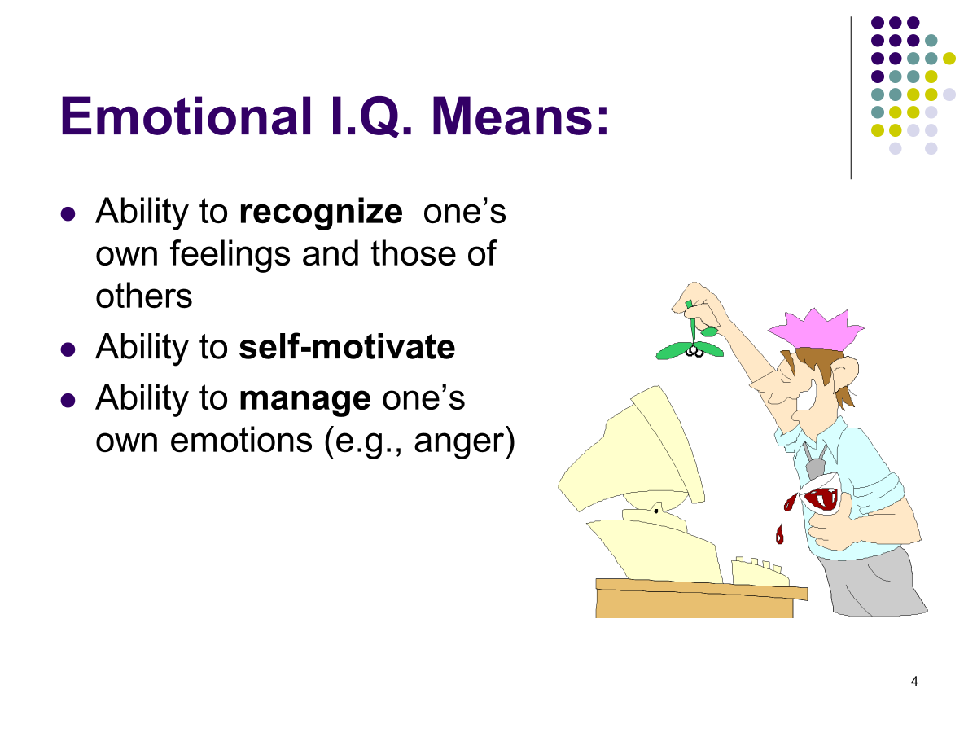

Slide 13
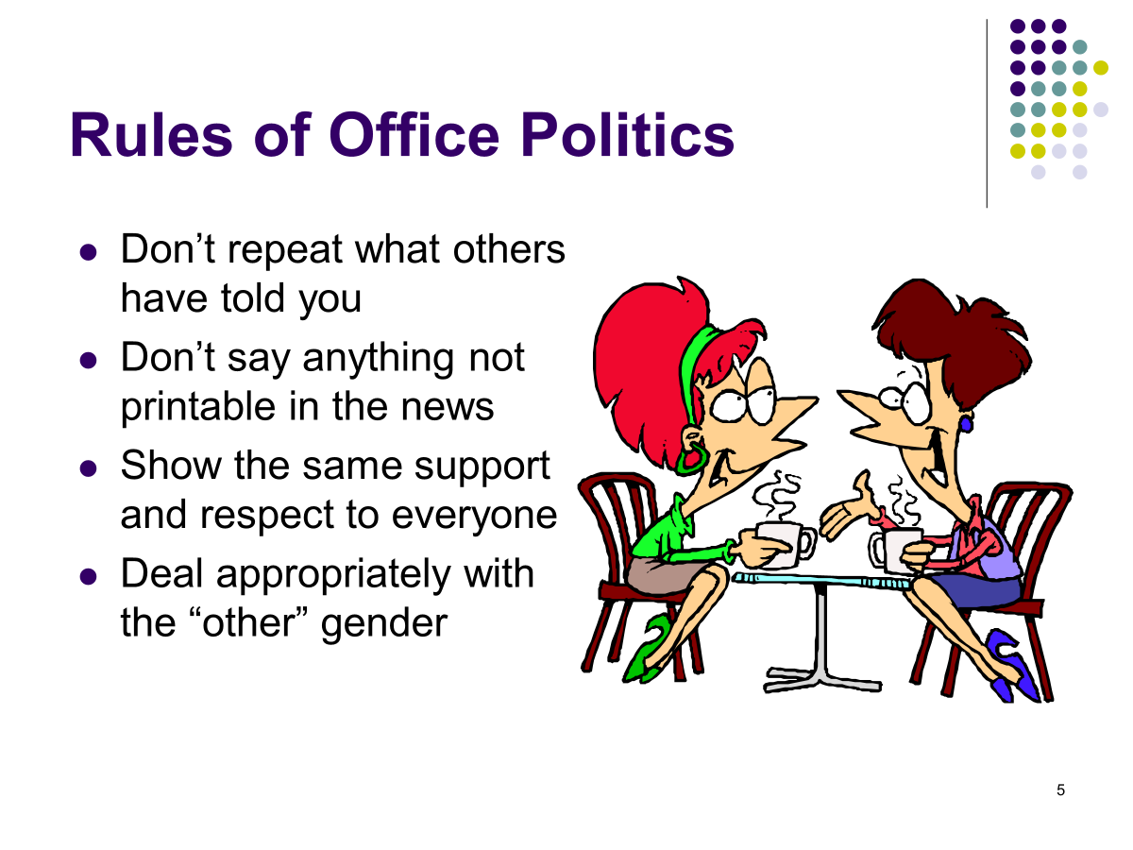

Slide 14
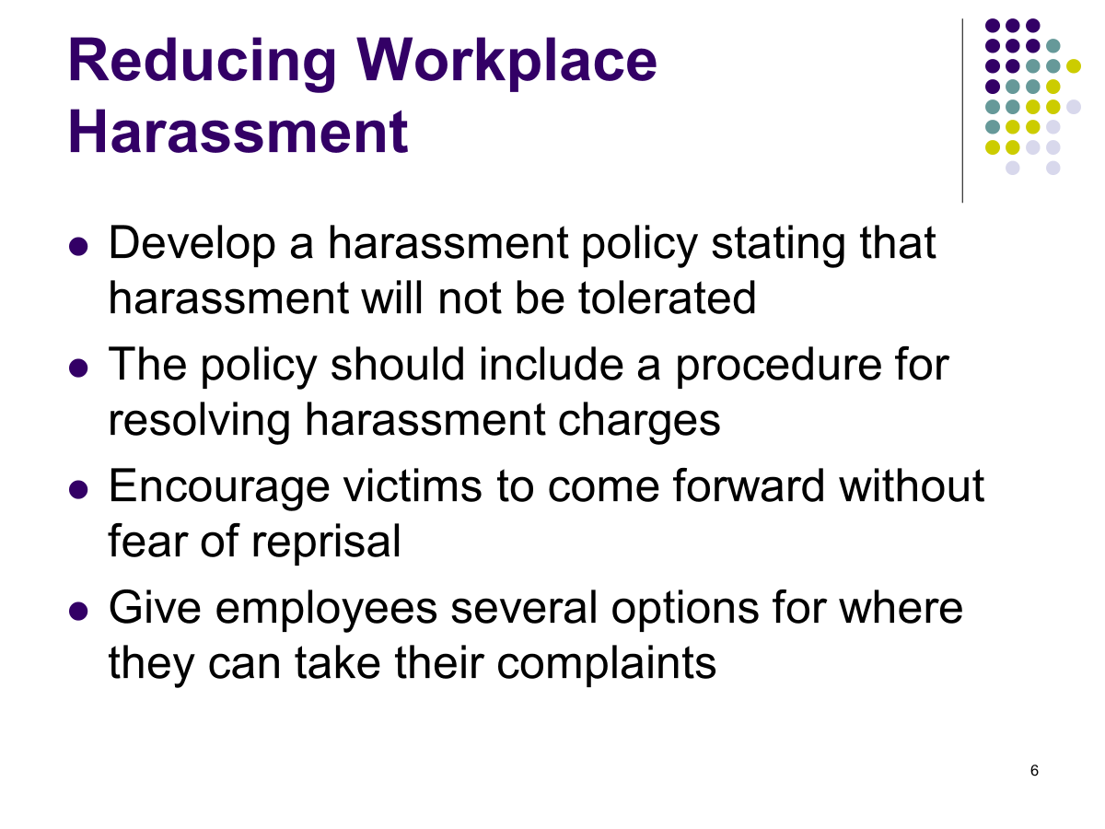

Slide 15
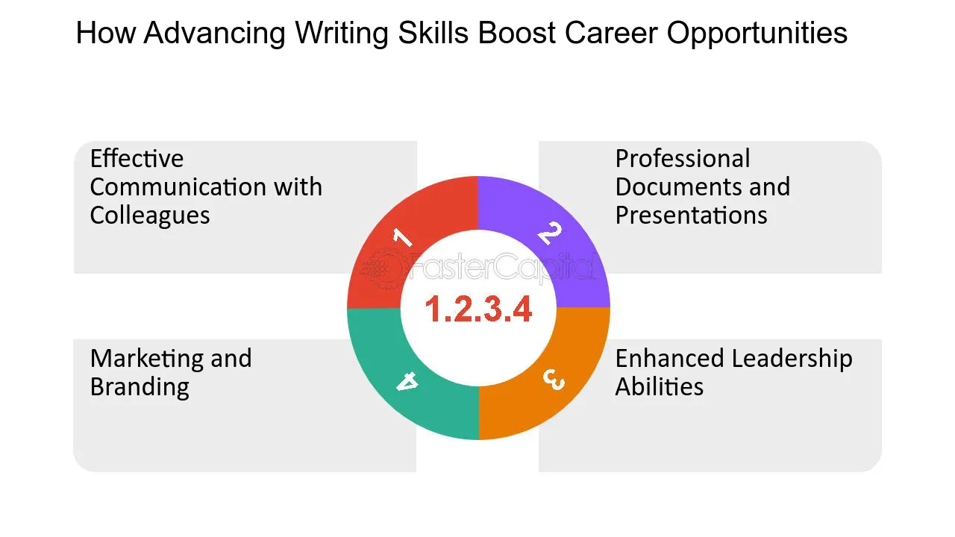
3.1.3. Career Advancement
Enhances leadership and persuasion skills.
Opens networking and career opportunities.
Aids in problem-solving and critical thinking.
Increases productivity and efficiency.
Strengthens relationships with colleagues and clients.
Boosts confidence and supports career growth.

Slide 16
3.1.4. Critical Thinking
Organizing Thoughts: Writing forces you to structure your ideas logically, helping clarify complex issues.
Analyzing Information: It requires evaluating data, evidence, and different perspectives before presenting conclusions.
Making Connections: Writing encourages connecting various ideas and identifying relationships between concepts.
Problem-Solving: It promotes breaking down problems into smaller parts, allowing for a more systematic approach to solutions.
Reflection and Evaluation: The process of writing enables reflection on thoughts and ideas, leading to deeper insights and self-assessment.
Developing Arguments: Writing helps in crafting well-supported arguments, demanding critical evaluation of facts and assumptions

Slide 17
3.1.5. Visibility and Influence
Writing skills help increase visibility and influence in several key ways:
1. Personal Branding
Writing articles, blogs, or social media posts allows you to share your expertise and showcase your knowledge, making you more visible to others in your field.
2. Networking
Well-crafted written communication (emails, messages, etc.) helps establish strong professional connections, increasing your influence within your network.
3. Thought Leadership
Publishing insightful, high-quality content on relevant topics positions you as an expert in your area, boosting your credibility and influence.

Slide 18
4. Persuasion and Advocacy(public support or recommendation )
Strong writing enables you to articulate compelling arguments and influence opinions, whether in professional settings or public forums.
5. Visibility in the Workplace
Clear, effective writing in reports, proposals, or internal communications makes your contributions stand out, enhancing your visibility within an organization.
Overall, writing helps you build a reputation, connect with a broader audience, and influence discussions in your field.

Slide 19
3.1.6. Documentation
Documentation plays a crucial role in improving writing skills in several ways:
Clarity and Organization: Good documentation requires clear, structured writing. Practicing documentation helps you learn to organize your thoughts and present information in a logical, coherent way.
Precision: Writing documentation demands precision and accuracy. This improves your ability to communicate exactly what you mean, reducing ambiguity and vagueness in your writing.
Consistency: When you document regularly, you develop a consistent writing style. Consistency in tone, terminology, and structure is important for clear communication, which enhances your overall writing skills.
Focus on Audience: Documentation is often written for a specific audience, requiring you to consider the knowledge level of your readers. This audience-awareness improves your ability to adapt your writing style to different contexts.

Slide 20
Attention to Detail: Documenting processes or technical details requires attention to detail. This habit sharpens your skills in ensuring accuracy and thoroughness in all forms of writing.
Improved Research Skills: Effective documentation often requires research to ensure completeness and correctness. This strengthens your ability to gather, evaluate, and synthesize information—skills that are invaluable for writing.
Conciseness: Documentation typically demands conciseness without losing important information. Learning to condense complex ideas into simple terms improves the clarity and brevity of your writing.
Practice: Regularly engaging in documentation provides constant practice, which is essential for refining and improving writing skills over time.

Slide 21
3.1.7. Global Reach
Writing skills help in achieving global reach by:
Clear Communication: Effective writing transcends language barriers, ensuring your message is understood worldwide.
Engagement: Well-written content attracts and retains a global audience, increasing your visibility.
Cultural Sensitivity: Writing with an awareness of diverse cultures helps you connect with international readers.
Online Presence: Strong writing enhances digital content (blogs, social media, websites), making it more shareable globally.
Professionalism: High-quality writing builds credibility and trust, opening doors to global opportunities.
Translation-Friendly: Clear and structured writing makes it easier for content to be translated into other languages.

Slide 22
3.1.8. Marketing and Branding
Writing skills are essential for marketing and branding in several ways:
Building Brand Voice: Writing defines a unique, consistent tone for your brand, helping you stand out and connect emotionally with your target audience.
Compelling Messaging: Strong writing creates persuasive content that highlights a brand’s value and drives customer engagement, whether through ads, blogs, or social media.
SEO and Content Marketing: Well-crafted, keyword-optimized writing improves your brand’s visibility in search engines, attracting more traffic and potential customers.
Trust and Credibility: Clear, professional writing helps establish trust and authority in your industry, making your brand more credible to consumers.
Customer Engagement: Through effective copywriting, storytelling, and personalized content, writing fosters deeper relationships with customers, encouraging loyalty and advocacy.
In summary, writing enhances a brand's identity, reach, and customer engagement, making it a powerful tool in marketing.

Slide 23


Slide 24
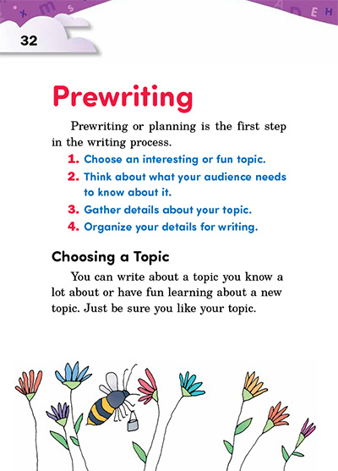
3.2 Pre-Writing- selecting a topic

Slide 25
Pre-writing refers to the initial stage of the writing process where a writer gathers and organizes ideas before drafting. It's essentially the brainstorming phase, and it helps in shaping the direction of the writing. Pre-writing can include activities like:
Brainstorming: Generating ideas on a topic or theme.
Freewriting: Writing without worrying about structure to let ideas flow freely.
Outlining: Structuring ideas into a logical format.
Researching: Gathering information, facts, or resources on a particular topic.

Slide 26
Selection of a topic
Selection of a topic is a critical part of pre-writing and involves selecting a subject to focus on in your writing. Choosing the right topic is essential to a successful piece of writing. The topic will determine the scope of your research, the depth of your analysis, and the structure of your writing. When choosing a topic, consider:

Slide 27
Know Your Interests: Select a topic you are genuinely interested in.Writing becomes much easier and more engaging when you choose a topic that excites or interests you. Reflect on subjects that you’re passionate about or curious to explore. A good topic will keep you motivated throughout the writing process.

Slide 28
2.Relevance to the Audience:
Choose something relevant to the assignment, audience, or field of study.
Consider your audience. Are you writing for an academic journal, a professor, a general reader, or a specific group of people? The topic should appeal to their interests and meet their expectations.
In academic contexts, it's important to choose a topic that contributes to the existing knowledge in your field.
3.Assessing the Scope: :
Too Broad: If a topic is too broad (e.g., “Global warming”), you might get overwhelmed by too much information and struggle to narrow down the focus.
Too Narrow: If a topic is too specific (e.g., “The effect of carbon emissions in one city block of Manhattan in August 2021”), you may struggle to find enough information to support your work.
Look for a middle ground: a topic broad enough to research but narrow enough to explore in detail.

Slide 29
Conducting a Preliminary Research:
Ensure there are enough resources available for research if necessary.
Before finalizing your topic, it’s wise to do a bit of preliminary research to see if enough material is available. This can save time in the long run and ensure that you have sources to support your ideas.
Formulating a Research Question:
After settling on a topic, try to convert it into a question. For example, if your topic is “The role of women in mythology,” you could ask, “How do the depictions of women in mythology reflect societal values and gender roles?”
A good research question helps to narrow down the focus of your study and give your writing a clear direction.

Slide 30
Flexibility:
Be flexible when choosing a topic. Sometimes you may find that as you begin to write or research, you need to adjust your topic slightly. Don’t be afraid to refine it as your understanding deepens.
Ensure that the topic is clear and specific enough to be explored effectively.
In academic writing, choosing the right topic and planning during pre-writing can significantly impact the quality of the final piece.

Slide 31
3.3 Writing- Free Writing, Drafting
What is the meaning of freewriting?
Freewriting is a writing exercise in which an author writes about whatever they are thinking about, without stopping, for a prescribed about of time. It is similar to stream-of-consciousness writing.
Freewriting
Freewriting is an informal writing process where the writer continuously writes for a set amount of time without worrying about grammar, punctuation, or organization. The purpose is to let thoughts flow freely without self-editing or worrying about structure.

Slide 32

Freewriting (also written as ''free writing'') is a writing technique that can help generate new ideas.
Freewriting involves writing non-stop for a continuous period of time and forgoing grammatical concerns.
It does not follow a structure or require a specific form or style. Also referred to as a stream-of-consciousness method, freewriting encourages the act of bouncing between ideas and following thoughts, even if they are not connected.
It is often used during the pre-writing phase, as people find it to be a useful brainstorming technique.
Benefits:
Encourages creativity and raw thinking.
Can reveal hidden thoughts and insights.
Great for brainstorming or starting off a new project.

Slide 33
Drafting
Drafting is the next step after pre-writing and freewriting. It involves taking the ideas from brainstorming or freewriting and forming them into a structured piece of writing. A draft is not meant to be perfect but is the foundation for later revisions.
Characteristics of Drafting:
Focused more on organizing ideas into paragraphs.
You start shaping your arguments, points, or narrative.
A draft may be rough but helps you see how the piece will look.

Slide 34
Strategies for drafting and finishing
Research information
Research Information If you do not know the topic, obviously you must learn about it.
For this you need to spend time in researching.
For searching the best way is to go to library or search on web
Place important material at the top You can also get information by interviewing people or experts.
2. Design your information to help Readers
To design your information, remember that you are creating an experience for your readers.
You are helping them to build a model.
You have to give the information that is helpful for the reader.
General principles
For an audience with little knowledge, use the familiar to explain the unfamiliar.
For readers familiar with some knowledge. Use accepted terminology.

Slide 35
3. Use context setting in introduction
Place important material at the top introduction Your introduction should supply an overall framework so that the reader can understand the details that later explain and develop it.
You can use an introduction in one of three ways:
i)To define terms
ii)To tell what caused you to write.
iii)And to explain the document’s purpose.
4 Use coordinate structure
Coordinate structure means that each section of a document follows the same organizational pattern. Readers react positively once they realize the logic of the structure you are presenting.
A good document must contain:
➤First a definition.
➤Followed by details.
And last explain the terms

Slide 36
5. Testing
Testing is asking other people to interact with your document in order to discover where it is effective and where it needs to be revision.
The document can be tested by the target audience or sometimes people familiar with the target audience to review the document.
6 Use preview lists
It is a list which contain the keywords to be used in a document. In any written communication the basic list has three components: an introductory sentence that ends in a “control word", a colon, and a series of items.
FOR EXAMPLE: A Test package Include Three
Parts: I. Test Plans
II. Test Specifications
III. Test

Slide 37
Difference:
Freewriting is unstructured and often personal, a process of getting ideas out.
Drafting is structured, with a focus on shaping these ideas into a coherent text.
Both freewriting and drafting are crucial for refining thoughts and ideas before completing a polished piece of writing.

Slide 38
3.4 Re-writing- Revision, editing, proofreading
Rewriting involves improving and refining your initial draft to enhance clarity, style, and overall quality. It consists of multiple stages, including revision, editing, and proofreading. Here’s an overview of these three steps:
1. Revision
Revision is the process of reviewing and restructuring the content. In this phase, you focus on improving the big picture aspects of your writing, such as:
Ideas and Arguments: Are your points clear and well-supported? Are there any missing or irrelevant ideas?
Organization: Is the flow logical? Do the introduction, body, and conclusion connect well?
Tone and Style: Is the tone appropriate for the audience? Does the writing style match the purpose?
Content: Make sure you are covering all necessary details and deleting anything unnecessary.

Slide 39
1.Confirming Purpose and Main Claim: The first step in the revision process is to confirm that the draft actually serves the purpose outlined in the introduction. In case the paper hasn’t done so, you need to either revise your purpose, or revise the paper so that it addresses the purpose. While this may seem straightforward, it is very possible for goals to change during the writing process.
2. Identifying and Checking Support for Major Claims: The main claim of the paper will be supported by sub-claims; these will need to be adequately supported as well. Ensure that you’ve provided sufficient supporting data (your own or from others) and explained how that information supports your claims.
3. Check Against Your Outline: Begin the revision process by comparing your first draft to your outline, and asking the following questions:
Does your draft match your outline?
If not, why not? Is your revision to the outline warranted, or would your original structure be better?
Where are the gaps in information in your draft; where might you have to add more information? What information is unnecessary, or tangential?

Slide 40
4.Identify and Evaluate Transitional Strategies: Transitions are the points at which we move between ideas in writing. They play a particularly important role in between sections and paragraphs, but operate within paragraphs as well. At each section break in your outline, you should be able to identify a transition strategy. Some transitional strategies include:
Logical: the last idea of the previous section/paragraph is the first idea of the next
Phrasal: using explicit wording to create a shift in writing/develop a relationship between the ideas in the previous and next sections/paragraphs
Structural: Using similar sentence structure to create a relationship between
Verbal: Using key words to establish a relationship between sections/paragraphs
.
5. Checking on a Paragraph Level: With each paragraph, you should be able to:
Easily identify a prominent and accurate topic sentence (near the beginning)
Identify the paragraph’s role in its section and in the document as a whole
Identify an organizational strategy or structure that the paragraph uses to accomplish its purpose; assess whether or not that structure is an efficient one, or if there may be a better structure (See Writing Process / Rhetorical Patterns)

Slide 41
2. Editing
Editing focuses on refining your writing at the sentence and paragraph level. Here, the goal is to improve:
Clarity: Are sentences clear and concise? Do they convey the message effectively?
Consistency: Is there a consistent point of view and tense? Are terms and concepts used uniformly throughout the piece?
Word Choice: Are you using precise and impactful words? Can you replace vague or repetitive words?

Slide 42
Manage Sentence Length: Short sentences clearly communicate individual ideas, but often leave connections between them unmade. Long sentences make connections between ideas, but can obscure individual ideas. Vary sentence lengths according to needs of section.
Strengthen the Grammatical Core of the sentence (Subject-Verb-Object): The subject (actor), the verb (action), and the object (what the actor performs the action on) constitute the grammatical core of the sentence, but the real subject, verb and object is often buried by complex or elaborate sentence structures.
The ASAP Principle: Avoid elaborate sentence structure, unless necessary. Good technical writing is always ‘As Short as Possible,’ while containing the necessary amount of detail. Cut away unnecessary phrasing whenever possible.
It is evident that this thesis provides a foundation from which engineers may astutely intervene for the betterment of the circuit board manufacturing process

Slide 43
3. Proofreading
Proofreading is the final step, where you look for minor errors in grammar, punctuation, spelling, and formatting. It's a surface-level check to ensure that the writing is polished and error-free. Here’s what you do:
Grammar and Punctuation: Check for subject-verb agreement, correct use of commas, periods, and other punctuation marks.
Spelling: Look for misspelled words or typos.
Formatting: Ensure that the document follows any required formatting guidelines (font size, margins, citations, etc.).
Allow enough time for several close readings of the text, with some break time in between to give you a fresh perspective on your document
Read each sentence aloud as you visually inspect the spelling and sentence structure; sometimes, reading the sentence aloud will allow you to spot mistakes that your eye can’t always see
Ask friends to read over your work to check for errors as an additional strategy; sometimes, outside readers can spot errors that the writer can miss. However, don’t rely on this as a primary proofing strategy: your proofreader doesn’t have anything invested in your report. You do, and are the one ultimately responsible for errors

Slide 44
When proofreading, you may want to try the following strategies.
Don’t rely on your computer’s spell check to correct all the spelling errors for you. Why?
Because Canadian and British spelling standards are different from American ones (standard on most spell checkers)
Because when you intend to sue ‘through,’ but forget the letter ‘r,’ your spell check will not register an error. (Can you see another small mistake in the above sentence that wouldn’t register? ‘Use,’ misspelled as ‘sue’)
Because the spell checker cannot ensure that the correct ending (agreement) has been used. ‘We ends the paper by . . .’ doesn’t register a spelling error, but ‘ends’ should be ‘end.’
And finally, because spell checkers often do not account for many of the specialized terms that are commonplace in engineering contexts – the spell check will identify many technical terms as errors simply because they are not in its dictionary
Don’t rely on your grammar checker to correct all of the grammatical errors for you. Why?
Because the rules implemented in the grammar checkers are rudimentary and simple, and don’t always allow for complex sentence structures. They may identify errors where there are none
They often don’t catch simple and straightforward errors, such as the ‘We ends’ example above (no error was reported by Microsoft Word)
Their suggestions will often substantially change the meaning of the sentences

Slide 45
Thank you

